Slide 1

Department of Computer Science
University Institute of Engineering
DEPARTMENT OF COMPUTER SCIENCE & ENGINEERING
Bachelor of Engineering
Subject Name: System Programming
Subject Code: CST-281
Compilers
DISCOVER . LEARN . EMPOWER

Slide 2
Chapter-2.1 Compilers
Department of computer Science
Introduction to Grammars and finite automata
Bootstrapping for compilers
Lexical Analysis

Slide 3
Grammars
Grammars denote syntactical rules for conversation in natural languages. InCompiler construction
Grammar is
A grammar G can be formally written as a 4-tuple (N, T, S, P) where −
N or VN is a set of variables or non-terminal symbols.
T or Σ is a set of Terminal symbols.
S is a special variable called the Start symbol, S ∈ N
P is Production rules for Terminals and Non-terminals. A production rule has the form
α → β
where α and β are strings on VN ∪ Σ and least one symbol of α belongs to VN.
Eg P : S → AB, A → a, B → b

Slide 4
Finite Automata
Finite Automata(FA) is the simplest machine to recognize patterns.
A Finite Automata consists of the following :
Q : Finite set of states.
Σ : set of Input Symbols.
q : Initial state.
F : set of Final States.
δ : Transition Function.

Slide 5
Finite Automata
Let L(r) be a regular language recognized by some finite automata (FA).
States : States of FA are represented by circles. State names are written inside circles.
Start state : The state from where the automata starts, is known as the start state. Start state has an arrow pointed towards it.
Intermediate states : All intermediate states have at least two arrows; one pointing to and another pointing out from them.
Final state : If the input string is successfully parsed, the automata is expected to be in this state. Final state is represented by double circles. It may have any odd number of arrows pointing to it and even number of arrows pointing out from it. The number of odd arrows are one greater than even, i.e. odd = even+1.
Transition : The transition from one state to another state happens when a desired symbol in the input is found.

Slide 6
Finite Automata
FA is characterized into two types:
1) Deterministic Finite Automata (DFA)
DFA consists of 5 tuples {Q, Σ, q, F, δ}.
Q : set of all states.
Σ : set of input symbols. ( Symbols which machine takes as input )
q : Initial state. ( Starting state of a machine )
F : set of final state.
δ : Transition Function, defined as δ : Q X Σ --> Q.
In a DFA, for a particular input character, the machine goes to one state only. A transition function is defined on every state for every input symbol.

Slide 7
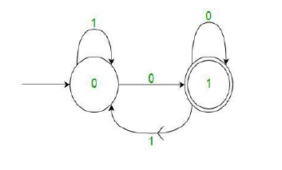
Finite Automata
Example : For example, below DFA with Σ = {0, 1} accepts all strings ending with 0.
One important thing to note is, there can be many possible DFAs for a pattern. A DFA with minimum number of states is generally preferred.

Slide 8
Finite Automata
2) Nondeterministic Finite Automata(NFA) NFA is similar to DFA except following additional features: 1. Null (or ε) move is allowed i.e., it can move forward without reading symbols. 2. Ability to transmit to any number of states for a particular input. However, these above features don’t add any power to NFA. If we compare both in terms of power, both are equivalent.
Due to above additional features, NFA has a different transition function, rest is same as DFA.
δ: Transition Function
δ: Q X (Σ U ϵ ) --> 2 ^ Q.

Slide 9
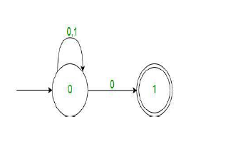
Finite Automata
As you can see in transition function is for any input including null (or ε), NFA can go to any state number of states. For example, below is a NFA for above problem
One important thing to note is, in NFA, if any path for an input string leads to a final state, then the input string accepted. For example, in above NFA, there are multiple paths for input string “00”. Since, one of the paths leads to a final state, “00” is accepted by above NFA

Slide 10
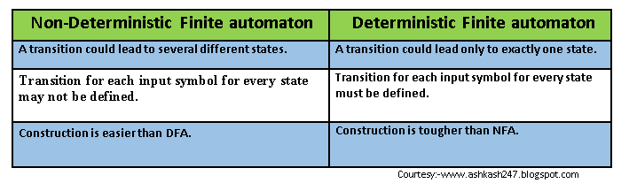
Difference Between NFA & DFA

Slide 11
COMPILER BOOTSTRAPPING
Bootstrapping is the process of writing a compiler (or assembler) in the source programming language that it intends to compile.
Applying this technique leads to a self-hosting compiler.
An initial minimal core version of the compiler is generated in a different language (which could be assembly language); from that point, successive expanded versions of the compiler are run using the minimal core of the language.
Many compilers for many programming languages are bootstrapped, including compilers for BASIC, Algol, C, D, Pascal, PL/I, Factor, Haskell, Modula-2, Oberon, OCaml, Common Lisp, Scheme, Go, Java, Rust, Python, Scala, Nim, Eiffel, and more

Slide 12
ADVANTAGES OF COMPILER BOOTSTRAPPING
Bootstrapping a compiler has the following advantages:
It is a non-trivial test of the language being compiled.
Compiler developers and bug reporting part of the community only need to know the language being compiled.
Compiler development can be done in the higher level language being compiled.
Improvements to the compiler's back-end improve not only general purpose programs but also the compiler itself.
It is a comprehensive consistency check as it should be able to reproduce its own object code.

Slide 13
Lexical Analyser
What is Lexical Analysis?
Lexical analysis is the starting phase of the compiler.
The lexical analyzer is responsible for breaking source code syntaxes into a series of tokens, by removing whitespace in the source code.
If the lexical analyzer gets any invalid token, it generates an error.
There are three terminologies-
Token
Pattern
Lexeme

Slide 14
Lexical Analyser
Token: It is a sequence of characters that represents a unit of information in the source code.
Pattern: The description used by the token is known as a pattern.
Lexeme: A sequence of characters in the source code, as per the matching pattern of a token, is known as lexeme. It is also called the instance of a token.

Slide 15
Roles and Responsibility of Lexical Analyzer
The lexical analyzer performs the following tasks-
The lexical analyzer is responsible for removing the white spaces and comments from the source program.
It corresponds to the error messages with the source program.
It helps to identify the tokens.
The input characters are read by the lexical analyzer from the source code.

Slide 16
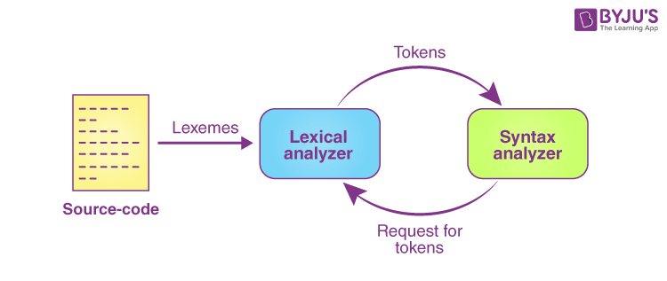
The Architecture of Lexical Analyzer

Slide 17
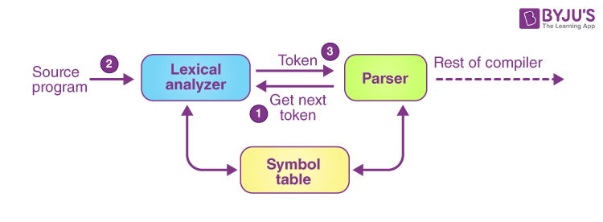
Working Diagram of Lexical Analyser

Slide 18
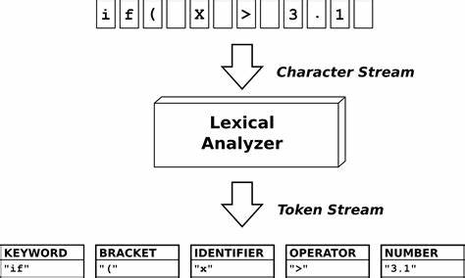
Example Lexical Analysis

Slide 19
Advantages/Disadvantages
Advantages of Lexical Analysis
Lexical analysis helps the browsers to format and display a web page with the help of parsed data.
It is responsible to create a compiled binary executable code.
It helps to create a more efficient and specialised processor for the task.
Disadvantages of Lexical Analysis
It requires additional runtime overhead to generate the lexer table and construct the tokens.
It requires much effort to debug and develop the lexer and its token description.
Much significant time is required to read the source code and partition it into tokens.

Slide 20
References
https://www.geeksforgeeks.org/bootstrapping-in-compiler-design/
https://www.javatpoint.com/bootstrapping
https://wiki.c2.com/?ChickenAndEggProblem
https://blog.asrpo.com/bootstrap_chicken_or_egg

Slide 21
THANK YOU

